Slide 1

Minimization of DFA

Slide 2


Equivalence
Two states p and q of a dfa are called indistinguishable if
δ (p, w) € F implies δ (q, w) € F,
and
δ (p, w ) ∉ F implies δ (q, w) ∉ F,
For all w € $\sum^{∗}{.}$ If, on the other hand, there exists some string w € $\sum^{∗}{.}$ such that
δ (p, w) € F and δ (q, w) ∉ F,
or vice versa, then the states p and q are said to be distinguishable by a string w

Slide 3
Minimization of DFA
Step 1: We will divide Q (set of states) into two sets. One set will contain all final states and other set will contain non-final states. This partition is called P₀.
Step 2: Initialize k = 1
Step 3: Find P_{k} by partitioning the different sets of P_{k-1}. In each set of P_{k-1}, we will take all possible pair of states. If two states of a set are distinguishable, we will split the sets into different sets in P_{k}.
Step 4: Stop when P_{k} = P_{k-1} (No change in partition)
Step 5: All states of one set are merged into one. No. of states in minimized DFA will be equal to no. of sets in P_{k}.
Minimization of DFA Suppose there is a DFA D < Q, Σ, q0, δ, F > which recognizes a language L. Then the minimized DFA D < Q’, Σ, q0, δ’, F’ > can be constructed for language L as:

Slide 4
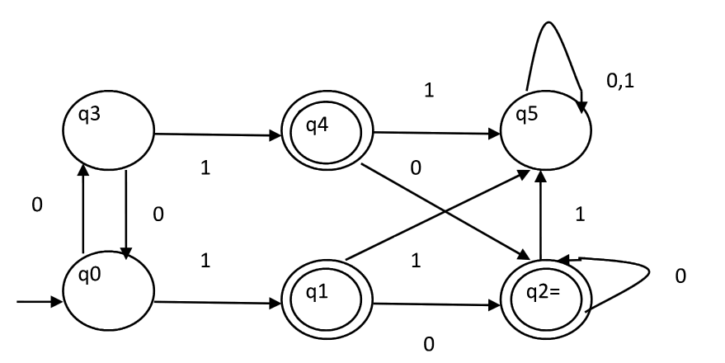
Question 1-

Slide 5
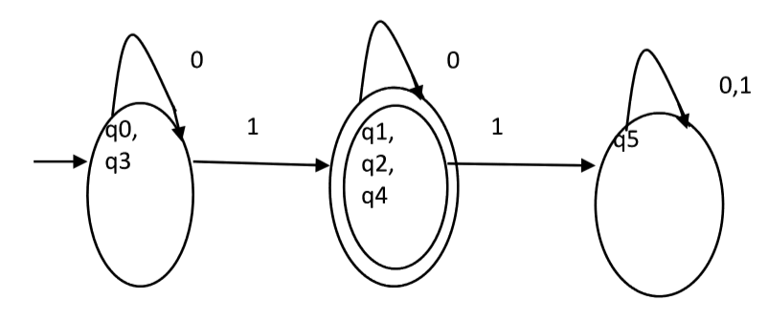
Solution 1-

Slide 6
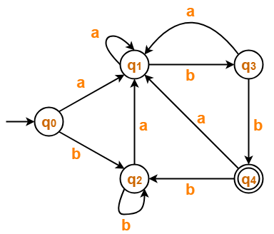
Question 2-

Slide 7
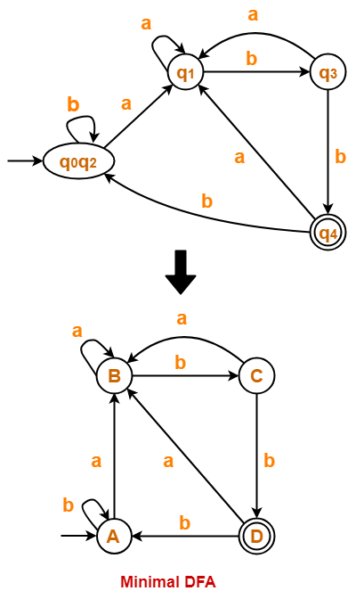
Solution

Slide 8
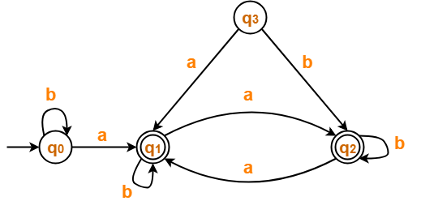
Question 3-

Slide 9
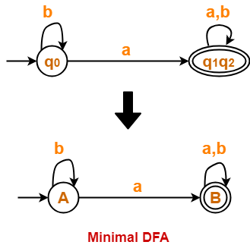
Solution 3-

Slide 10
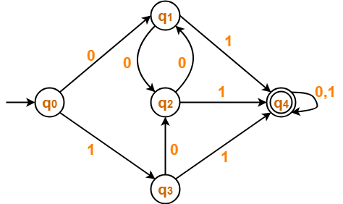
Question 4-

Slide 11
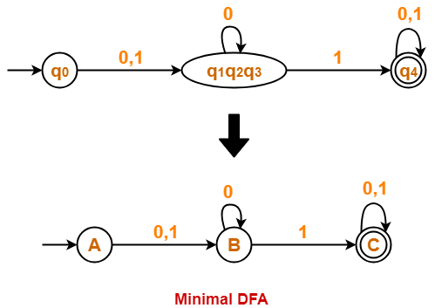
Solution 4-

